Slide 1
Hi-Tech Management System
Presented by: Xiao Su
Ao Hu
Teacher : Quang Hoang Cao

Slide 2
Project Description
Hi-Tech Distribution Inc. Description
  supplying products to the colleges and universities in Quebec
Project Description
  design and implement a windows-based application

Slide 3
Project Development Process
Analysis
Field: products, suppliers, clients, order, employee, users
Design
Class diagram
Three-tier model
Implement
Development tools
Division and individual responsibility
Operation: save/update/delete/search/list
Security: password
GUI design

Slide 4
Technical Points
  Three-tier model
  Applying Object-Oriented Concepts:
    Encapsulation Inheritance polymorphism
  Using Interfaces
  Creating and Using the Class Library Project
  Creating and Using Custom Windows Controls in GUI classes
  Data Storage
  Temporary : Using Collection Classes;
  Persistent : Using Files (Sequential / Binary/XML)

Slide 5
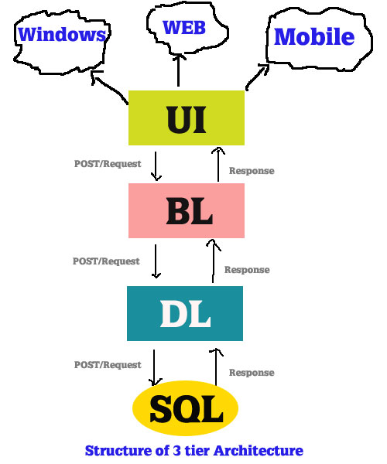
Three-tier model

Slide 6
Three-tier model
It makes the logical separation between business layer and presentation layer and database layer.
As each tier is independent it is possible to enable parallel development of each tier by using different sets of developers.
Easy to maintain and understand large project and complex project.

Slide 7
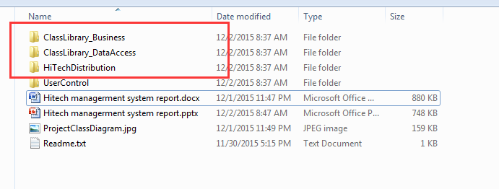
Three-tier model

Slide 8
Class Diagram

Slide 9
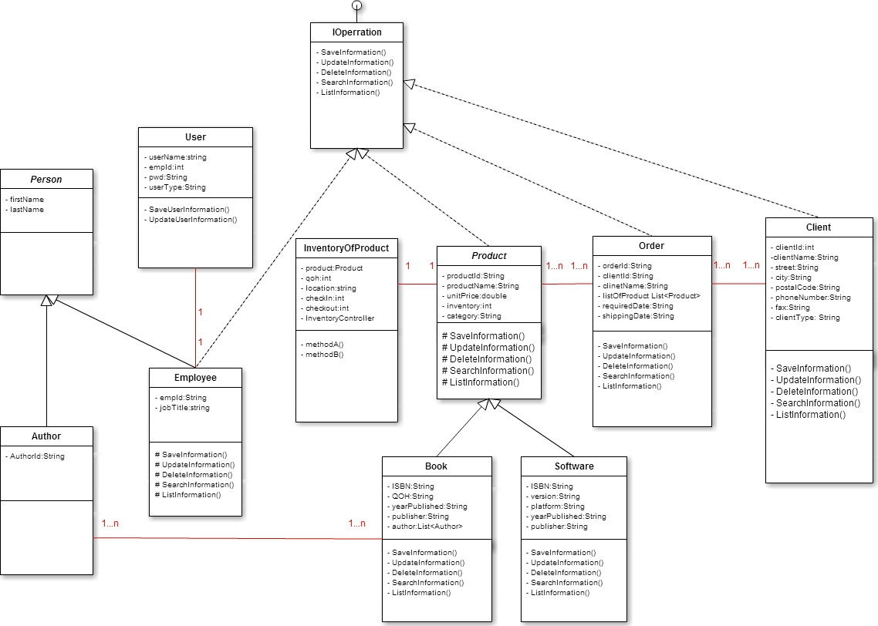

Slide 10
Team Work
Our divisions are:
Xiao Su is responsibility to develop Order, Client relevant issues, and initial implement of this project.
Ao Hu is responsibility to develop Product, Employee, User relevant issues

Slide 11
Team Work
AnkhSVN is a Subversion Source Control Provider for Microsoft Visual Studio 2005-2013 and 2015.
AnkhSVN provides Apache™ Subversion® source code management support to all project types supported by Visual Studio and allows you to perform the most common version control operations directly from inside the Microsoft Visual Studio IDE.

Slide 12
Team Work
The Pending Changes dashboard gives you a unique insight in your development process and provides easy access to the source code and issue management features. The deep source code control (SCC) integration allows you to focus on developing, while AnkhSVN keeps track of all your changes and provides you the tools to effectively handle your specific needs.

Slide 13
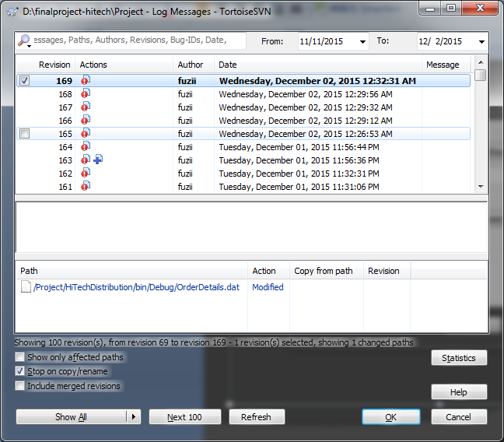
Team Work

Slide 14
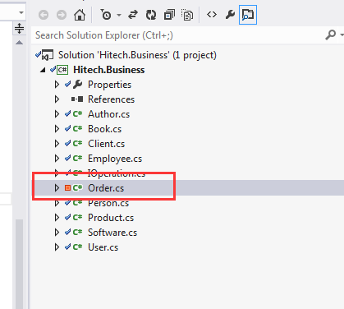
Team Work

Slide 15
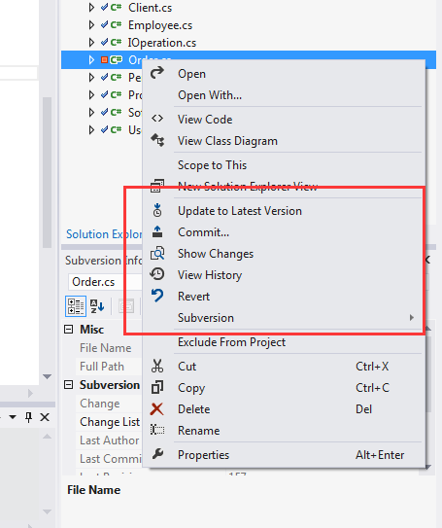
Team Work

Slide 16
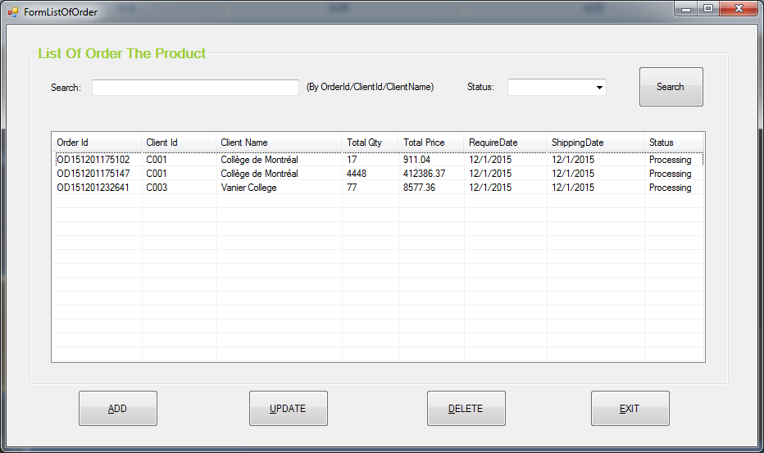
Order implement

Slide 17
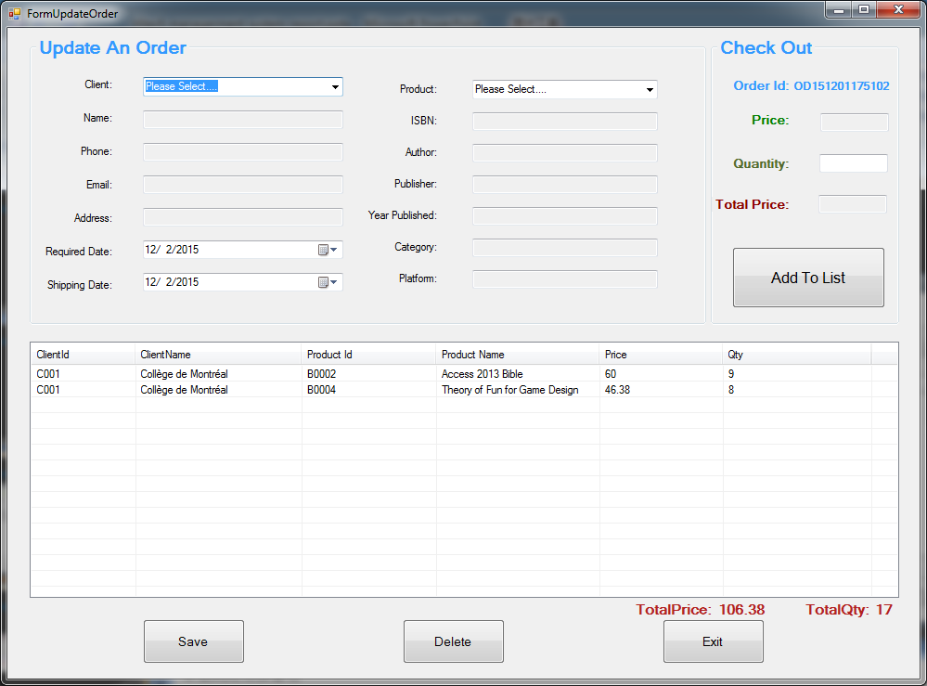
Order implement

Slide 18
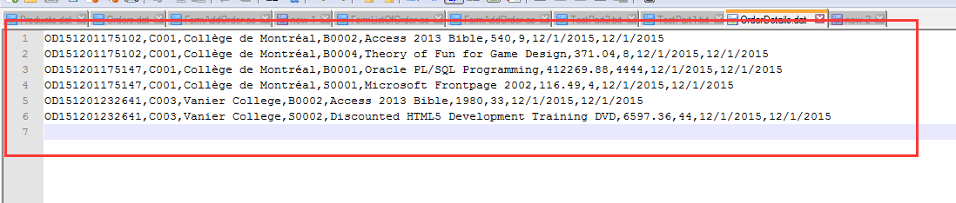
Order implement

Slide 19
Conclusion
Design Problem:
1. Abstract class should not implement Interface class
2. Quantity should not belong to Product class

Slide 20
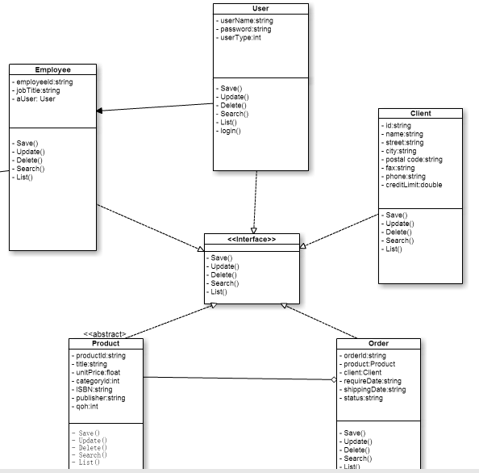
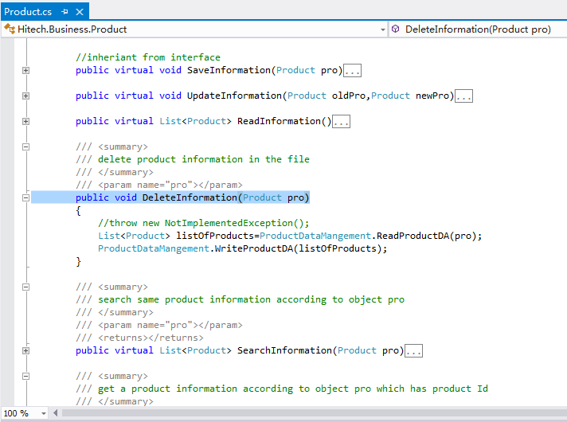
Conclusion
Design Problem:

Slide 21
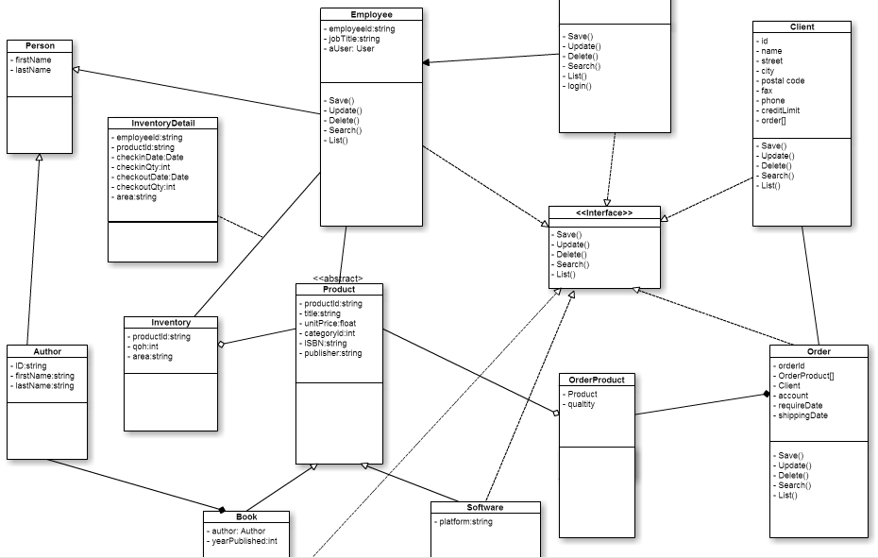
Conclusion
Design Problem:

Slide 22
Conclusion
Three-tier model Problem:
1. Data Access layer should only do simply jobs with file.
2. Cross-reference problem.

Slide 23
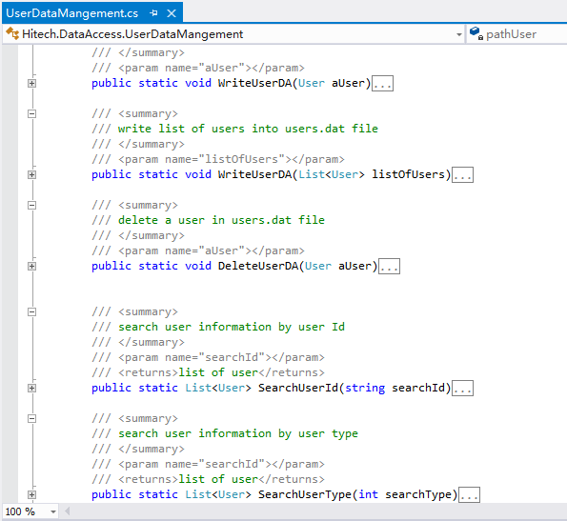
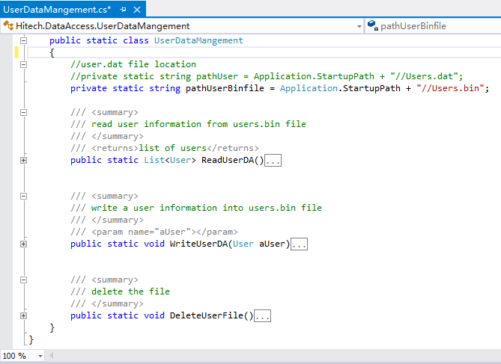
Conclusion
Three-tier model Problem:

Slide 24
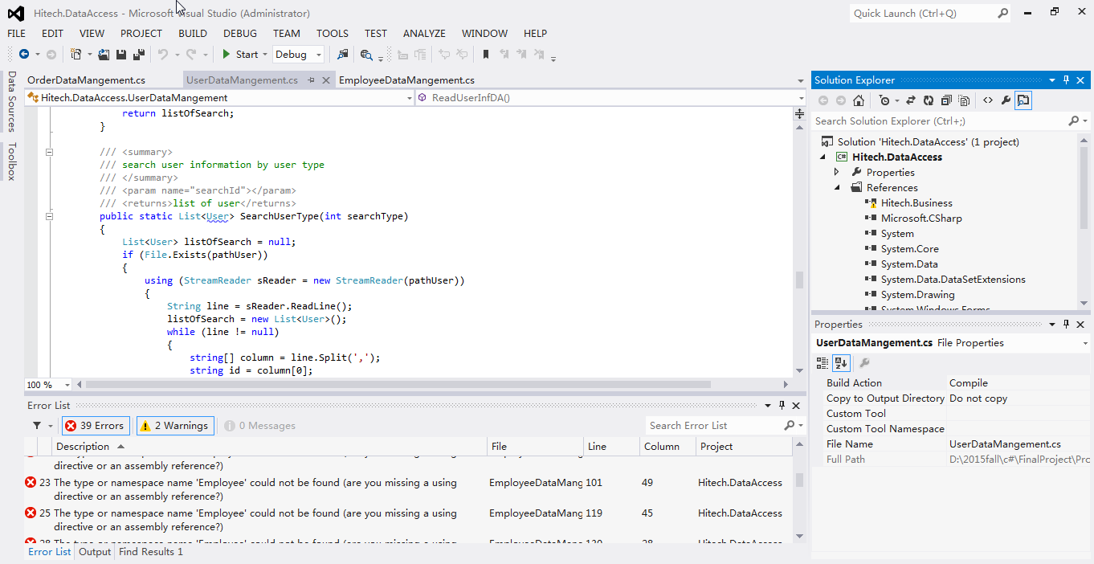
Conclusion
Three-tier model Problem:

Slide 25


